Slide 1
HPI Admin Spread Amalysis
File created on: 9/23/2024 8:29:38 AM

Slide 2
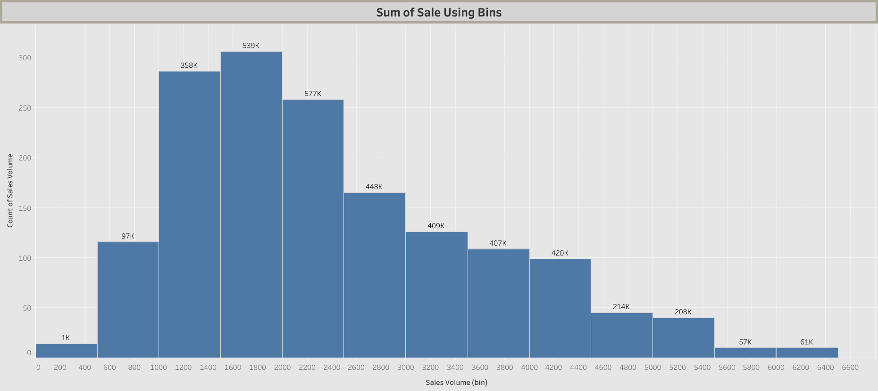

Slide 3
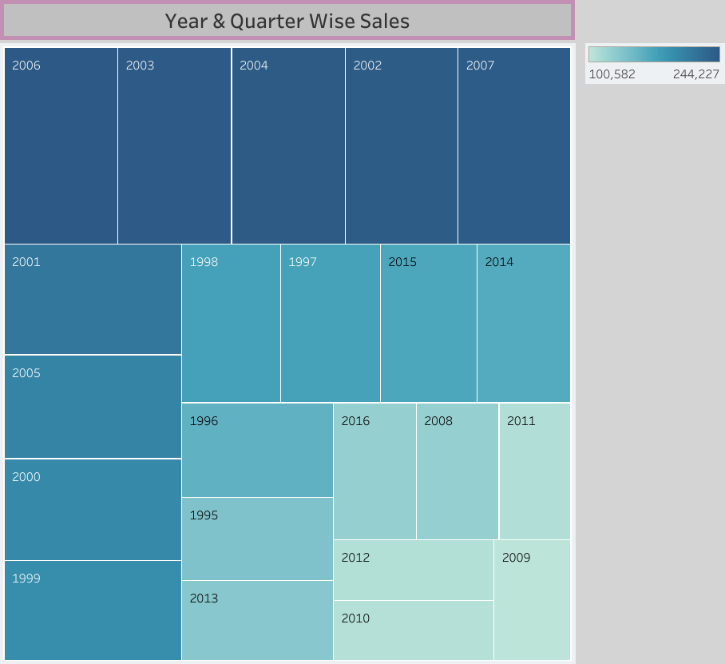

Slide 4
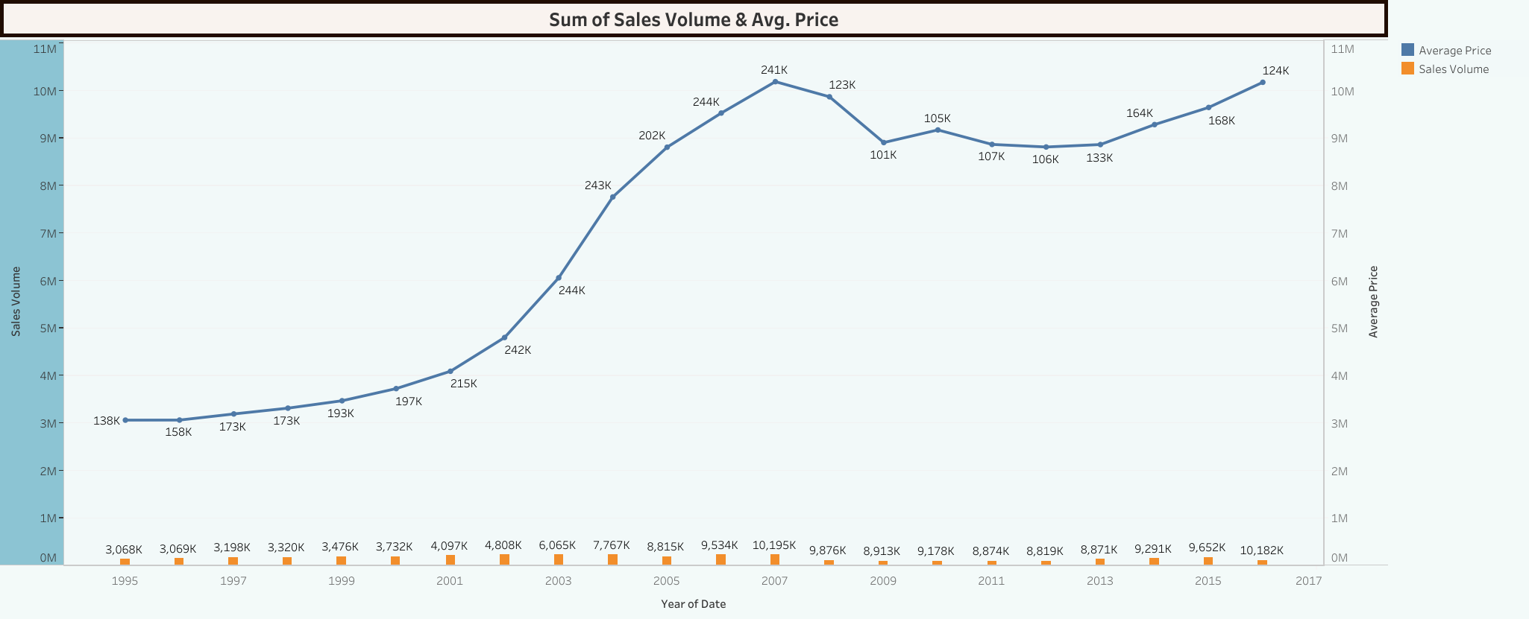

Slide 5
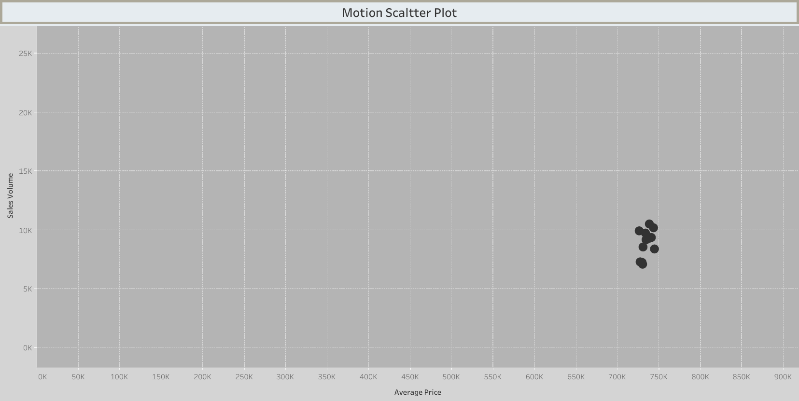

Slide 6
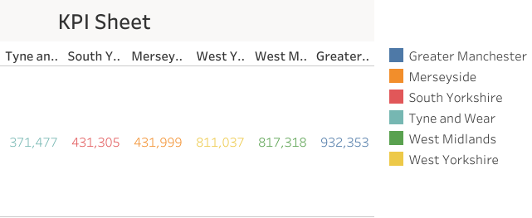

Slide 7
